Slide 1

Sales meeting
2004 H2

Slide 2
Agenda
Current progress and forecast
Changes in sales trends
Salespeople performance
Product overview
Regions and customers overview

Slide 3
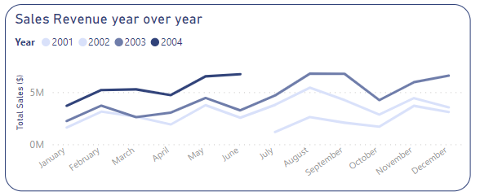
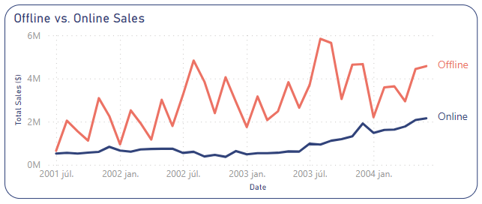
Current progress and forecast
Overall peak
Total sales revenue surpasses the previous year so far, but it is impotrant to be aware of upcoming higher season!
32,1M
19,3M
Expected growth for upcoming higher summer season:
What are the necessary measures to take?
Possible solutions: - Set a target Sales value for the upcoming season
- Launch a campaign for summer

Slide 4
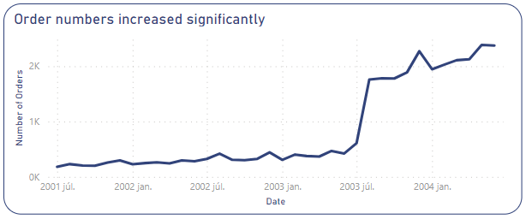
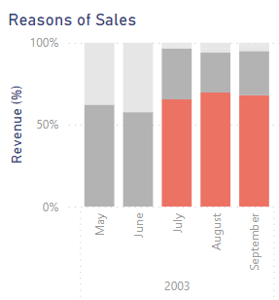
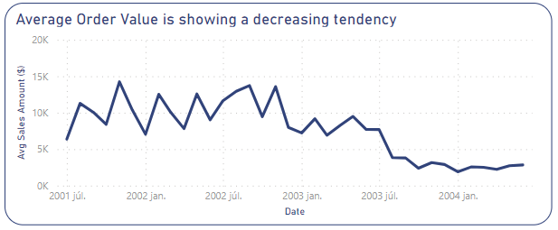
Changes in sales trends
2386
1 of the possible reasons: new prices got introduced a year ago and became the drive of sales:
290%
184
Promotion
14k
Price
50%
1,9k
Possible solutions: - Marketing strategies to increase basket value (personalized recommendation, shipping discounts etc)

Slide 5
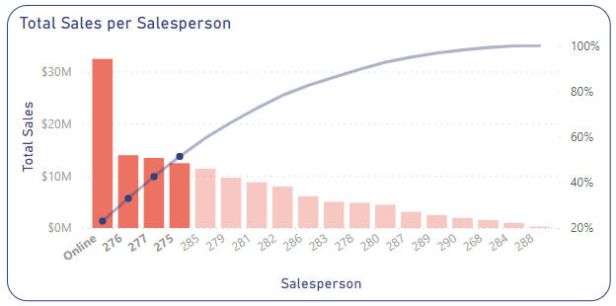
Salespeople performance
Online sales and top 3 Salesperson generated 50% of the total revenue
50%
How can we close the gap?
Possible solutions: - Further training for salespeople who are below average
- Collect useful tips and strategies from high performing salespeople and pass them on to the lower performing salespeople

Slide 6
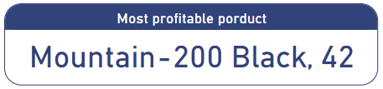
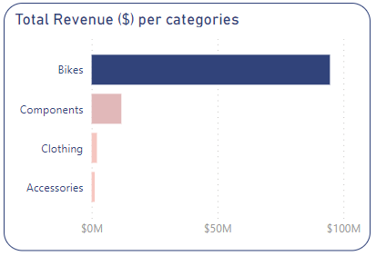
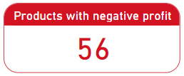

Product overview
Highest revenue is coming from the Bikes category, other categories are significantly lower:
(Generates loss)
Possible solutions: - Adjust prices to avoid having negative profit products – Important!
- Develop strategies to increase the revenue of lower categories
- Create bunle offers, free shipping, improve webpage design to promote lower categories

Slide 7
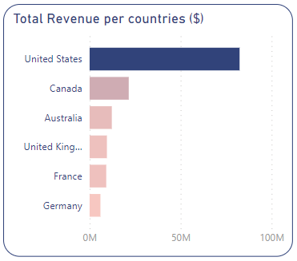
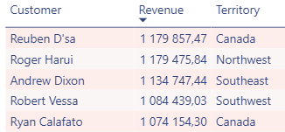
Regions and customers overview
More than 50% of revenue is from the United States, while European countries generated the least.
All the top customers are from North America:
What do they do differently?
What strategies work the best?
Possible solutions: - Apply sales strategies from the US in other countries as well
- Further investigate general market and customer behaviour to identify patterns
- Create loyalty program to increase return rate
- Improvements for higher customer satisfaction (reviews)

Slide 8
Summary of Insights
Upcoming higher season
Make sure the sales excel during this period
The Average Order Value dropped in the last year
Find ways to increase AOV in order to increase total revenue
Identified lower sales channels (online & offline)
Change strategies for advertisement platform
Improve lower performing salespeople’s performance
Most category’s revenue needs improvement
Adjust prices to avoid having negative profit products
Implement new strategy to overcome this issue
More than 50% of revenue is from the United States
Take steps to increase revenue of other countries

Slide 9
Thank you!

